Slide 1




MITRON BANK CREDIT CARD ANALYSIS
CODE BASICS RESUME PROJECT CHALLENGE #8
PRESENTED BY MOULI DAS

Slide 2
Presented to Mr. Bashnir Rover
Agenda :
Data Modelling Mastery
Problem Statement Insight
Dashboarding Proficiency
Dataset Relationship Building
Strategic Recommendations

Slide 3
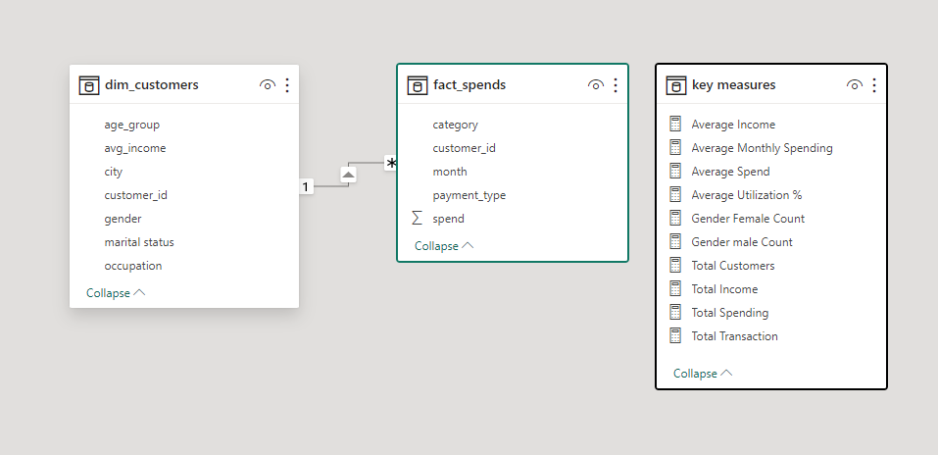
DATASET
The "DIM_CUSTOMER" table contains information about customers, including their age group, average income, city, customer ID, gender, marital status, and occupation.
The "FACT_SPEND" table represents spending data, detailing categories of spending, customer ID, month, payment type, and the corresponding spend amount.

Slide 4
Problem Statement
Mitron Bank is a legacy financial institution headquartered in Hyderabad. They want to introduce a new line of credit cards, aiming to broaden its product offerings and reach in the financial market.
OBJECTIVE : Conduct a thorough analysis of a sample dataset comprising 4000 customers' online spending and related details across five cities. Deliver key insights to guide Mitron Bank's strategy in customizing credit cards to align with customer needs and market trends. The goal is to impress Mr. Bashnir Rover and the strategy team with impactful, data-driven recommendations for project success.

Slide 5
Let’s get into the Dashboard

Slide 6
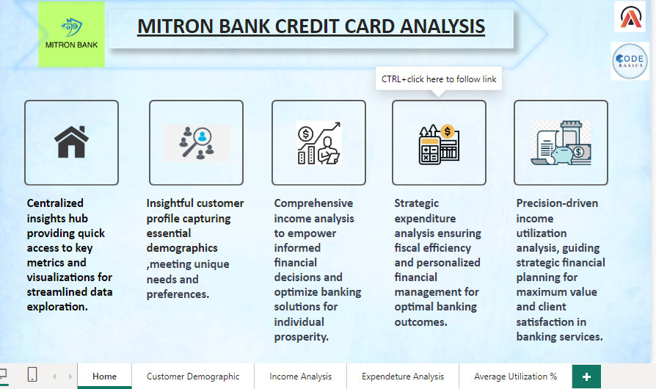

Slide 7
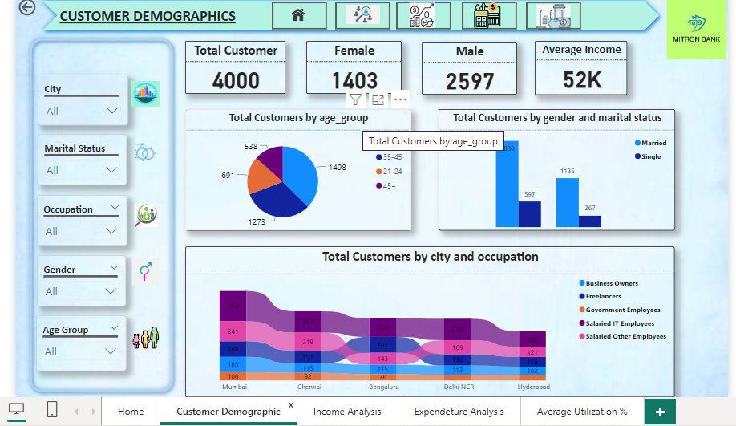

Slide 8
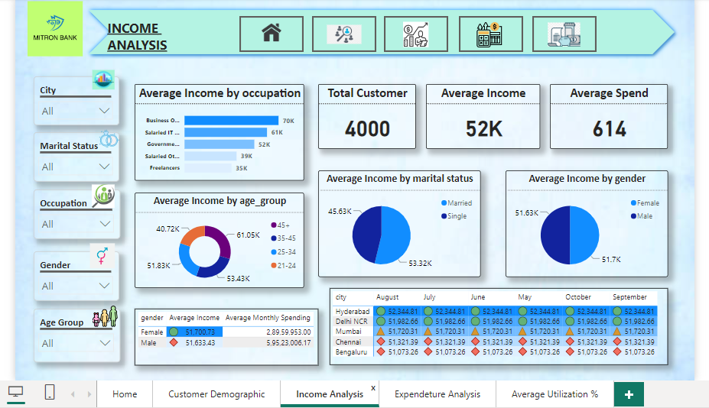

Slide 9
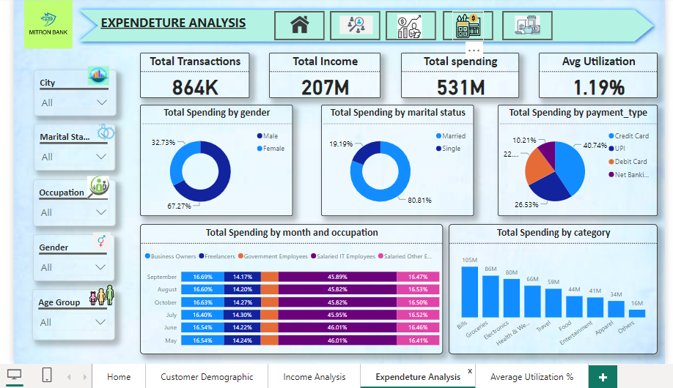

Slide 10
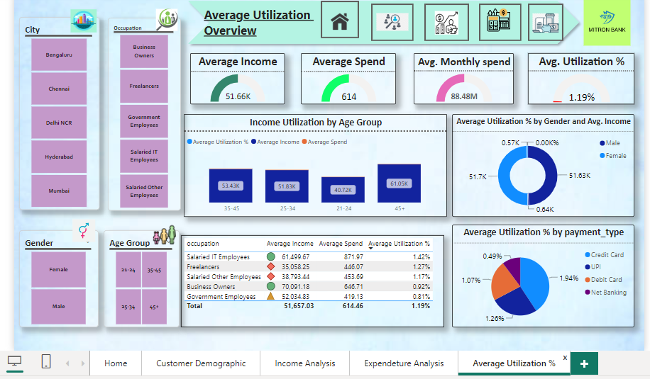

Slide 11
Key Insights : Total Customer Base: Our customer base comprises a robust 4000 individuals. Gender Dynamics: Males lead the demographic with 2597, while females account for 1403 customers. Income Overview: The average income stands at a solid $52,000. Age Group Distribution: The age group 25-34 boasts the highest customer count. Marital and Gender Mix: Married individuals dominate the demographic, making up 2000 customers. Gender distribution highlights a majority of male customers. City and Occupation Peaks: Mumbai emerges as the top city in our customer landscape. Salaried IT employees form the largest occupational group, with a substantial count of 364.
Comprehensive insights on Customer Demographics

Slide 12
Comprehensive insights on Income and Expenditure
Occupation Dynamics:
Business owners stand out with the highest average income at $70,000, emphasizing their financial capacity.
Freelancers, while valuable contributors, exhibit a more conservative average income of $35,000.
Age Group Variations:
The 45+ age group commands the highest average income, reaching an impressive $61,050. This segment represents a lucrative market with substantial financial means.
Marital Status Impact:
Married individuals demonstrate a robust average income of $53,320, indicating potential spending capacity.
Singles maintain a respectable average income of $45,630, showcasing individual financial stability.
Gender-Based Income Patterns:
Females marginally outpace males in average income, with females at $51,700 and males at $51,630. Understanding these nuances aids in gender-specific financial product customization.
Gender Influence:
Males lead spending at 67.27%, showcasing strong financial engagement.
Females contribute 32.73%, reflecting diverse spending habits.
Marital Impact:
Married individuals drive spending significantly at 80.81%.
Singles contribute 19.19%, highlighting individualistic preferences.
Payment Trends:
Credit cards dominate at 40.74%, emphasizing tailored credit card offerings.
UPI follows at 26.35%, indicating a growing trend in digital transactions.
Top Spending Category:
Bills lead with $105 million, underscoring the importance of essential expenses.

Slide 13
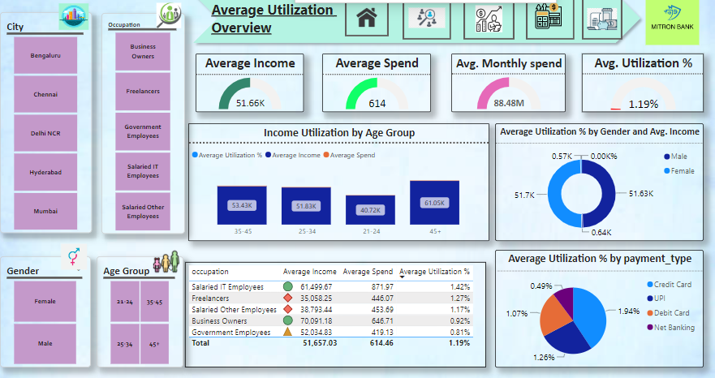
Comprehensive insights on Average Utilization Percentage
Optimized Utilization in 45+ Age Group:
The 45+ age group, boasting the highest average income at $61,050, demonstrates an efficient financial approach.
With balanced spending habits, this age segment showcases a commendable average utilization percentage, indicating responsible financial management.
Gender-Neutral Financial Behaviors:
Negligible gender-based variations in average income, with females at $51,700 and males at $51,630.
Both genders exhibit comparable average utilization percentages, suggesting a balanced and responsible approach to financial utilization.
Credit Card Dominance in Utilization:
Credit cards lead with the highest average utilization percentage at 1.94%, emphasizing their effectiveness in meeting consumer financial needs.
Other payment types exhibit diverse utilization percentages, emphasizing the importance of tailoring strategies based on payment preferences.

Slide 14
Strategic Recommendations
Youth-Centric Credit Cards:
Target Group: 25-34 Age Group
Recommendation: Launch credit cards with features catering to the lifestyle and preferences of young professionals, such as exclusive discounts on popular entertainment and tech services.
Family-Oriented Credit Packages:
Target Group: Married Individuals
Recommendation: Introduce credit card packages offering joint rewards, family vacation perks, and discounts on family-related expenses to appeal to the family-oriented spending patterns.
Urban Lifestyle Campaigns:
Target Group: Mumbai Residents, Salaried IT Employees
Recommendation: Develop marketing campaigns highlighting credit card benefits tailored for urban lifestyles, including discounts on city experiences, tech gadgets, and lifestyle services.
Business Elite Credit Cards:
Target Group: Business Owners
Recommendation: Introduce a premium credit card with exclusive perks for business owners, such as enhanced expense management tools, business-related travel benefits, and industry partnerships.
Bills Category Bonuses:
Target Group: All Customers
Recommendation: Promote credit cards with increased rewards or cashback for bills payment, encouraging customers to consolidate their regular expenses on Mitron Bank credit cards.
Digital Transaction Incentives:
Target Group: UPI Users
Recommendation: Launch promotional campaigns offering bonus rewards or cashback for transactions made using UPI, aiming to increase customer engagement in digital payments.
Financial Planning Credit Cards:
Target Group: 45+ Age Group
Recommendation: Introduce credit cards with features focused on long-term financial planning, including retirement benefits, investment advice, and exclusive partnerships for financial services.
Gender-Neutral Rewards:
Target Group: All Genders
Recommendation: Ensure credit card rewards and benefits are gender-neutral, promoting inclusivity and equal opportunities for all customers.
Freelancer Support Initiatives:
Target Group: Freelancers
Recommendation: Launch targeted educational campaigns and credit-building programs for freelancers, addressing their unique financial needs and providing tools for financial stability.
Category-Specific Promotions:
Target Group: All Customers
Recommendation: Periodically run promotions highlighting specialized benefits or specific spending categories, encouraging customers to diversify their spending on Mitron Bank credit cards.

Slide 15
Thank You!
Name : Mouli Das
Contact details : mouli.das9494@gmail.com

